Slide 1




Python - Loops
Takrorlash Operatorlari

Slide 2
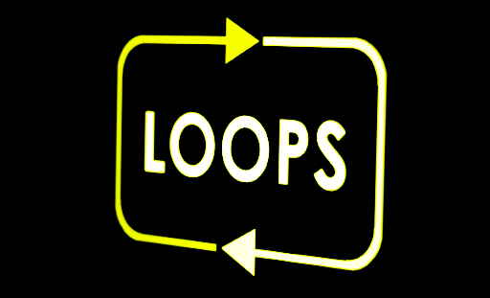
Pythonda 2 xil sikl operatori mavjud:
For
while

Slide 3
Misol
For Loops
For sikli list , tuple, dictionary, set, string kabi ketma-ketliklarni iterasiya qilish uchun ishlatiladi
fruits = ["apple", "banana", "cherry"] for x in fruits: print(x)

Slide 4
Looping Through a String
for x in "For loop example": print(x)

Slide 5
Misol 1
Misol 2
6 dan 15 gacha bo’lgan sonlarni ekranga chiqazadigan dastur tuzing.
0 dan 10 gacha bo’lgan (0,1,2,3,4,5,6,7,8,9) sonlarni ekranga chiqazadigan dastur tuzing
for x in range(10): print(x)
for x in range(6, 15): print(x)

Slide 6
Misol
While loop
1 dan 20 gacha bo’lgan juft sonlarni ekranga chiqazing.
While yordamida shart false qiymat qabul qilmaguncha ma’lum bir amallar ketma-ketligini takror-takror bajarilishini ta’minlash mumkin.
i = 1 while i < 20: if i % 2==0: print(i) i += 1

Slide 7
The range() Function
Belgilangan amallar ketma-ketligini bir necha marta takror bajarish uchun range() funksiyasidan foydalaniladi

Slide 8
Nested Loops
color = ["red", "green", "yellow"] fruits = ["apple", "peach", "cherry"] for x in color: for y in fruits: print(x, y)
Nested Loop – bu sikl ichida sikldir

Slide 9
The continue Statement
The break Statement
break yordamida siklni shart True bo’lgan holda ham to’xtatishimiz mumkin
continue yordamida siklning joriy qadamini to’xtatishimiz mumkin
i = 1 while i < 20: print(i) if i % 3 == 0: continue i += 1
i = 1 while i < 20: print(i) if i % 3 == 0 and i % 5 == 0: break i += 1

Slide 10
Misol
While with else
1 dan 20 gacha bo’lgan sonlar yig’indisini hisoblang.
Shart True bo’lmaganda sikldan chiqishda bir marta bajariladi
sum=0
i = 1 while i < 20: sum+=i i += 1 else: print("Sikl tugadi")
print("Yig'indi: {} ga teng".format(sum))

Slide 11
Misol 3
Else in For Loop
6 dan 15 gacha bo’lgan 3 ga karrali sonlarni ekranga chiqazadigan dastur tuzing.
for x in range(10): print(x) else: print('Sikl tugadi')
for x in range(6, 15, 3): print(x)

